Slide 1
DeFaketector
the deep fake fact checker
powered by Artificial Incompetence
(we’re not incompetent, we promise)

Slide 2
Real
Fake

Slide 3
Initial Challenge
Given synthetic data, the state of the art model achieves 70% accuracy
HOWEVER
Different resolutions
Blurry videos (background)
Real videos that UN will have to deal with
Generalizable approach

Slide 4
Old models vs new techniques¹
Future: We will need a ‘anti-virus’
1: 8000 papers submitted to one conference this year alone!

Slide 5
We need a more holistic approach
Which actively collects data, as it emerges, by engaging people who encounter it
Only using video is not enough
Consider:
A video by a newly created account with 0 subscribers, made 3 days before an important election

Slide 6
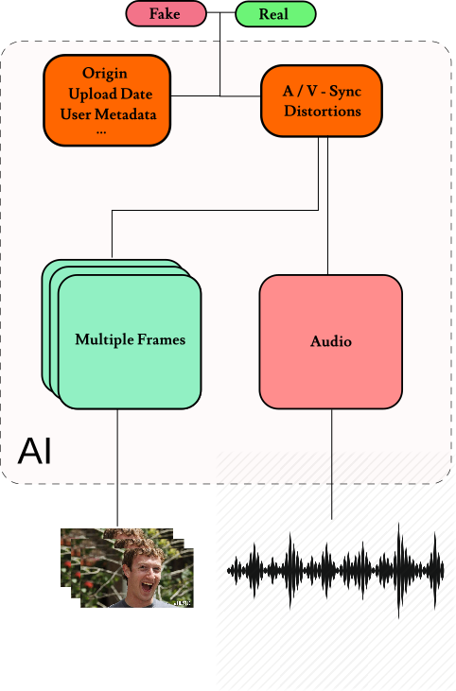
How will we tackle this?
Use additional information
Engage the user

Slide 7
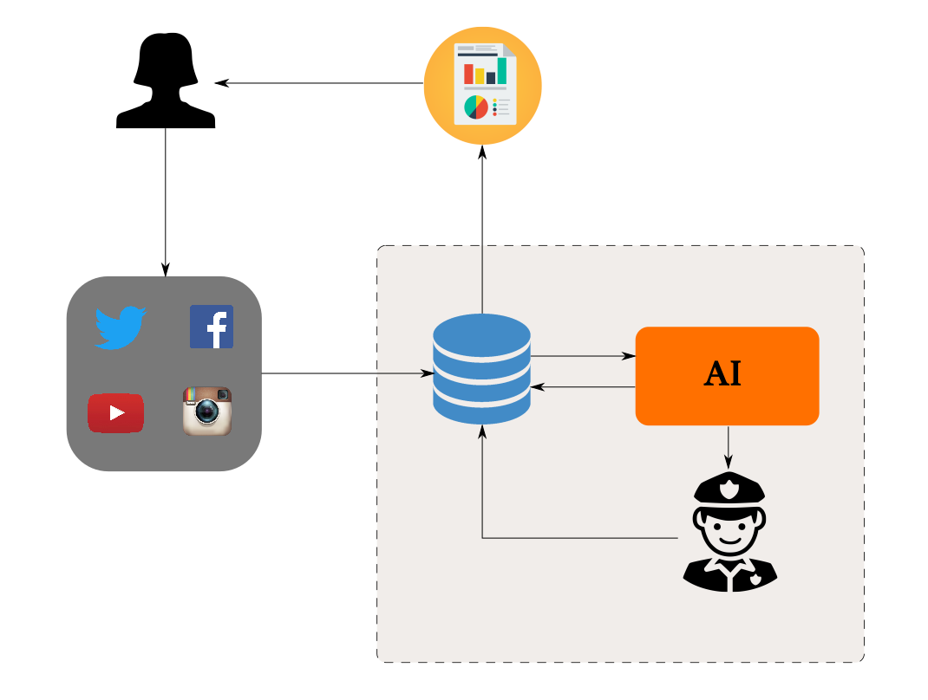
How will we tackle this?
Use additional information
Engage the user

Slide 8
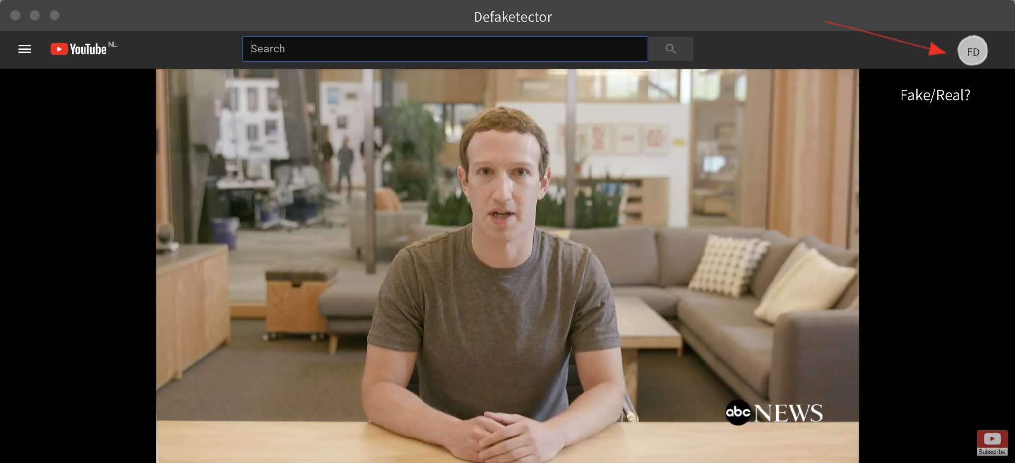

Slide 9
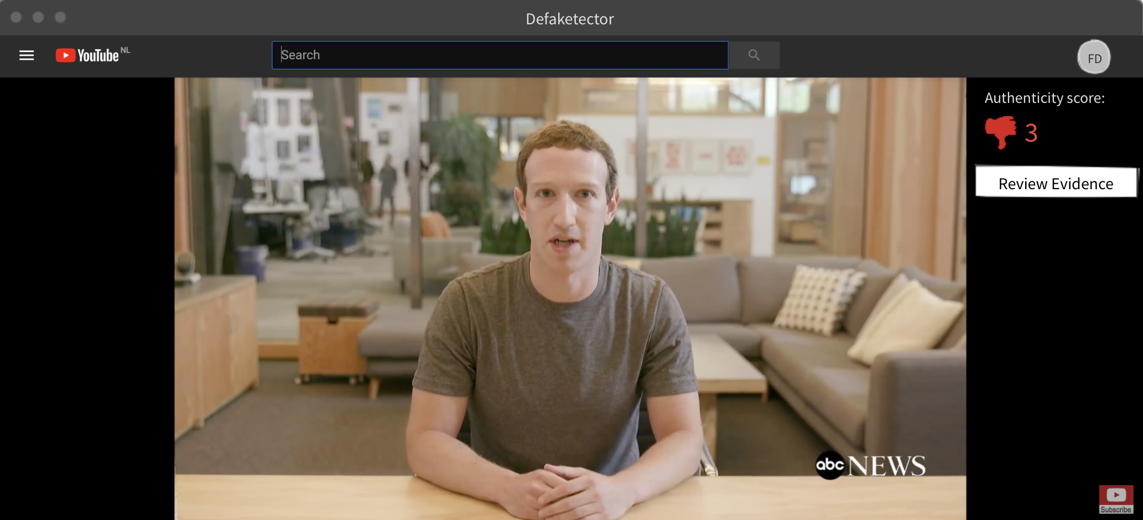

Slide 10
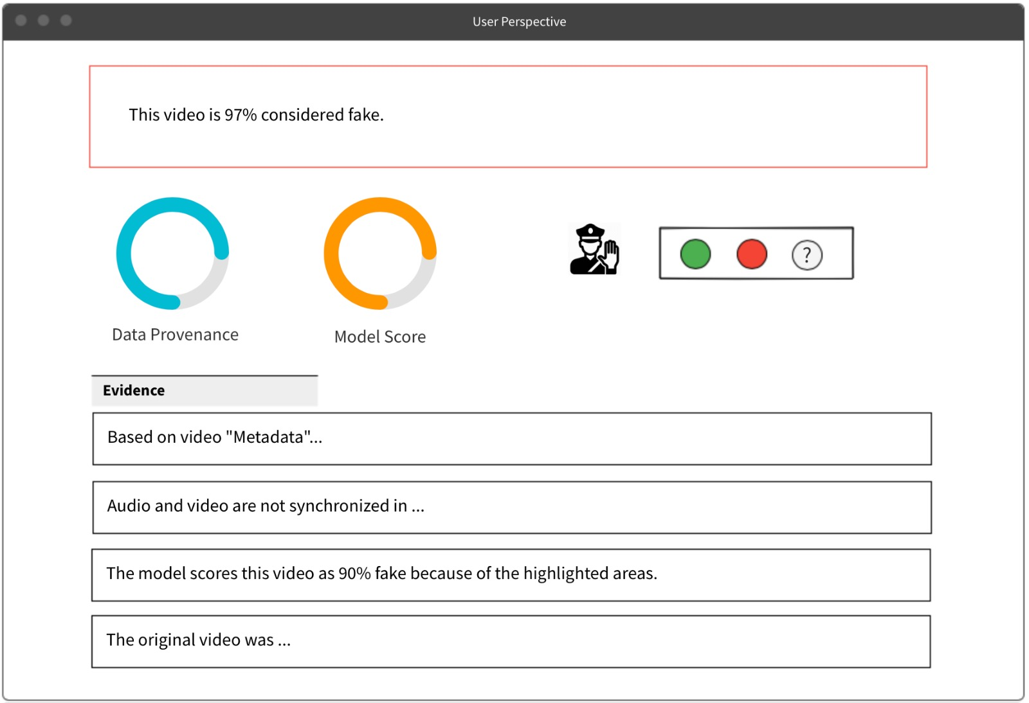

Slide 11
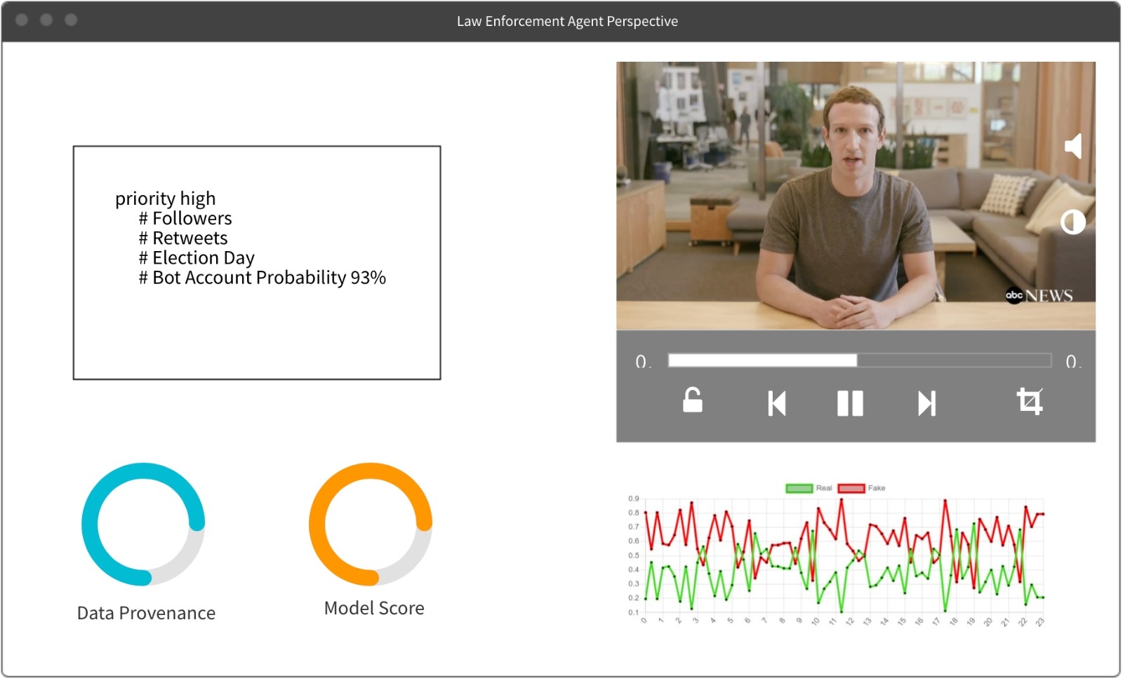

Slide 12
Practical feasibility
‘Tech stuff’
What: Model that uses ‘video’ instead of stills: Can ‘inflate’ Frame models for Video¹
What: Model that uses audio²
What: Model that uses metadata
‘Legal stuff’
Viable, but we need licenses to be compliant with EU regulations
Be careful with where we store data and who we share it with
1: (13D) Quo Vadis, Action Recognition? A New Model and the Kinetics Dataset
2: Looking to Listen: Audio-Visual Speech Separation

Slide 14
To summarize:
Real world data
More information
Faster intervention , Better Models
Let the world hack for peace, justice and security!

